Slide 1
2022-2023 Welcome
Year 13 Information Evening

Slide 2
Agenda
Introduction Katherine Davis, Senior Assistant Principal
Expectations Katherine Davis, Senior AP
Personal Development Katherine Davis, Senior AP
Careers Katherine Davis, Senior AP
Tutor time programme Katherine Davis, Senior AP
A-Level courses John Marks, Head of Sixth Form
Extended Project Qualification John Marks, Head of Sixth Form
Post-18 (UCAS) John Marks, Head of Sixth Form
Supporting your child Katherine Davis, Senior AP
Questions

Slide 3
Priorities for Year 13
To accept only the very best of themselves – TO HAVE A VISION
No limits, no barriers, no excuses to success or learning
To be fully aware of the challenges this year,
but not stressed by them
To be fully prepared for the next steps,
understanding that they are laying the foundation for lifelong success
Be competitive

Slide 4
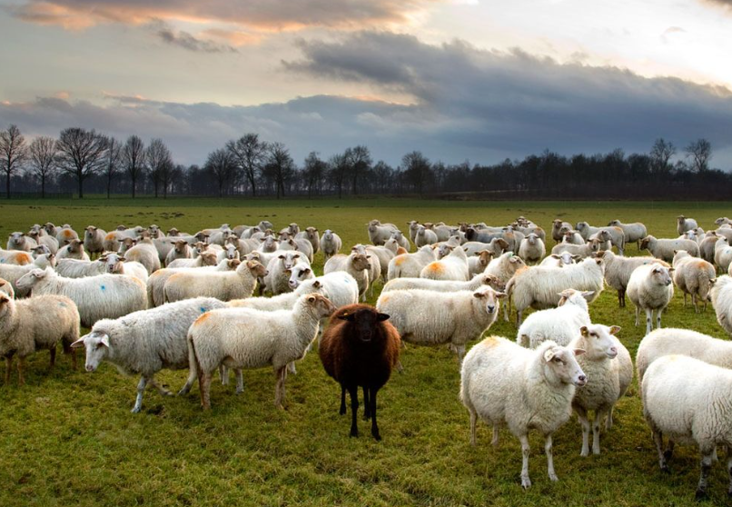

Slide 5
Attendance
Attendance is the key to success!
Our target as a school is 97% attendance. No more than 5 days per year.
Arrive by 8.30am
Signing in/out at with Ms Lindo if going into the Village
Doctor/medical/dental appointments, out of school hours

Slide 6
Dress code
Smart/casual dress code. Sixth Formers represent the Sixth Form, and the School
We do not allow:
sportswear (except for during sport)
Hoodies
faded/ripped denim
scruffy trainers, high-heeled shoes, platform shoes
cropped/strappy tops
mini skirts or shorts
Full description of dress code on our website

Slide 7
Personal Development
Co-curricular clubs run at lunchtime everyday, and after school on Tuesday and Thursday
Duke of Edinburgh’s Silver Award
Combined Cadet Force, Unit with Ashford School, every Wednesday 4-6pm
Leadership roles in Sixth Form
Volunteering e.g. upcoming Open Evening 2nd Nov, 5.30-7pm

Slide 8
Careers
Study/Life Skills sessions during PSHE lessons (twice fortnightly)
All of Year 13 have received a one to one Careers Guidance session from our independent careers advisor Chris Targett
Unifrog & UCAS
MyPath
Next Steps Newsletter and Teams notifications

Slide 9
Tutor Time and PSHE
Tutor time everyday, 8.35-9.10am
Monday- UCAS job applications
Tuesday- 1:1 and Revision Skills
Wednesday- UCAS
Thursday- 1:1 and Revision Skills
Friday- Briefing
All of Sixth Form have two PSHE lessons a fortnight, focusing on Life Skills. Additionally, Sixth Form participate in Drop Down Days every half term including, for example, Sex Education, Study Skills

Slide 10
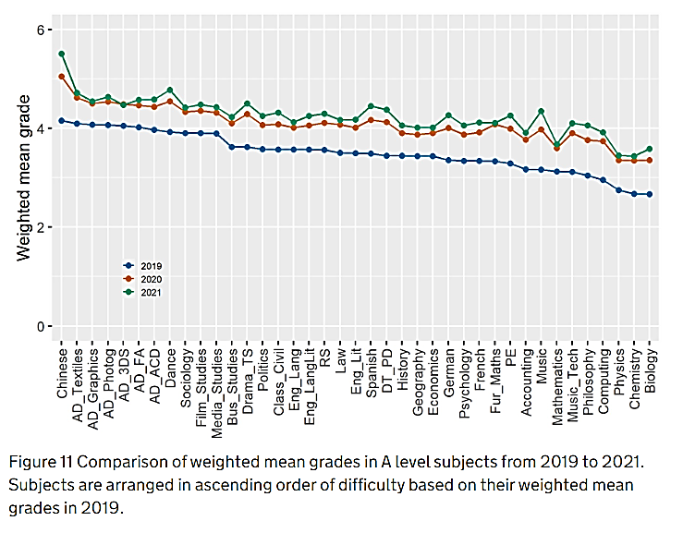
https://www.gov.uk/government/publications/an-investigation-of-inter-subject-comparability-in-gcses-and-a-levels-in-summer-2021/an-investigation-of-inter-subject-comparability-in-gcses-and-a-levels-in-summer-2021

Slide 11
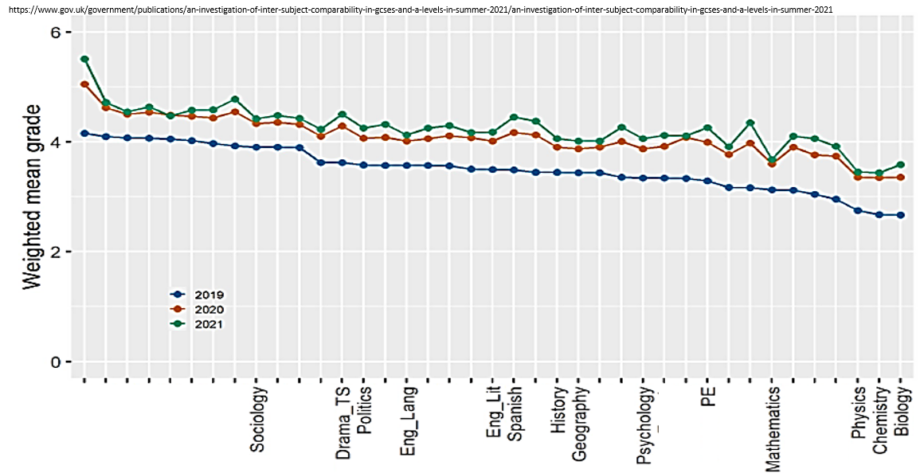
https://www.gov.uk/government/publications/an-investigation-of-inter-subject-comparability-in-gcses-and-a-levels-in-summer-2021/an-investigation-of-inter-subject-comparability-in-gcses-and-a-levels-in-summer-2021
Sociology
History
Drama
Politics
Eng lan
Geography
Psychology
PE
Chemistry
Maths
Biology
Physics
National A level results subject ranked 2022
Wye A level results subject ranked 2022

Slide 12
Independent Study
Study Periods to be used for:
completion of homework;
independent review of course content;
Super-curricular research;
completion of UCAS/Unifrog;
preparing for tutor time presentations;
Volunteering
Homework: students should spend the same amount of time in independent study as taught time in the classroom
e.g. 6 lessons of Maths per week, should mean 6 study periods spent on independent study for Maths

Slide 13
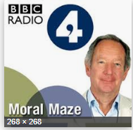
Super-Curricular -

Slide 14
Super-Curricular cont.
Books e.g. “Very short introduction to… “ short books of c.150 pages, £2.39
iTu – iTunes University
(for apple devices)
Academic competitions
Isaac – (Physics)
Visits
edX
Khan Academy
Coursea.org
FutureLearn
@univstaircase12
MOOCs – massive open online courses – send you reminders each week
Look for, but don’t be limited by your course’s reading list

Slide 15
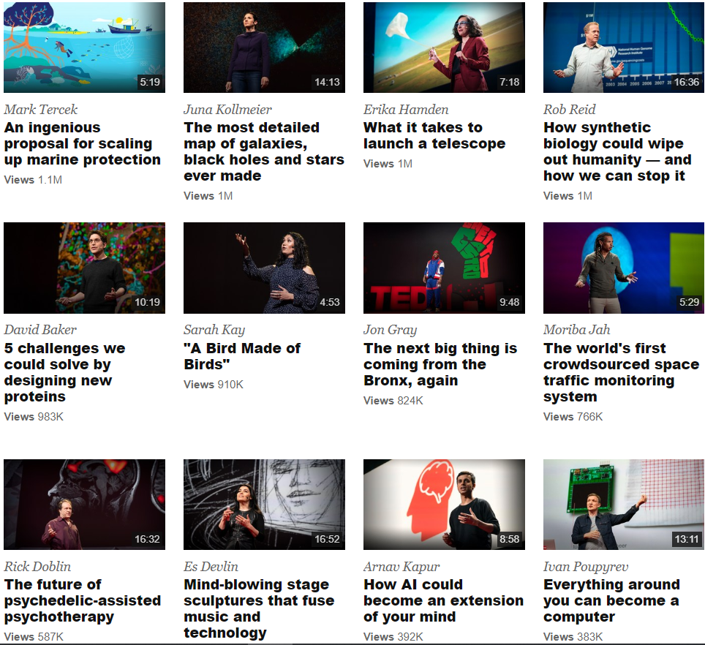

Slide 16
Independent Study
All Sixth Form students have been issued a Chromebook
Homework is set via Satchel One
Some subjects use Teams or One Note for lessons and work submission
If students miss a lesson, they are expected to catch up

Slide 17
Independent Study-Revision Timetables
Tests & mocks matter!
A revision timetable will help your son or daughter plan their time and achieve the most - avoid last minute panics and cramming.
Be honest and realistic – do they work best in the mornings, afternoons or evenings?

Slide 18
UCAS
UCAS is how you apply to University
Sixth Form students start preparing Personal Statements, on Unifrog, for their UCAS applications in summer 2023.
Some Art Colleges & foundation courses
have their own application processes
Deadline for UCAS submissions is 10 December 2022 for September 2023 entry.
Even if your child doesn’t want to go to university, the preparation of writing a Personal Statement is very useful.

Slide 19
Other routes
If your child is interested in a degree-apprenticeship an apprenticeship or traineeship, we can also help to support

Slide 20
How well is my child doing?
From the mock exams (7 -15 December), you will receive the following:
Current Grades – This indicates the level they are currently working at.
Target Grades – This is an aspirational grade based on their Key Stage 2 SATS scores. If they achieve their target grade, they are making excellent progress.
Predicted Grade – This is the grade we think they will achieve at the end of the course.
Learning Indicator – This is an effort grade. It can be either Poor, Requires Improvement, Good or Excellent.

Slide 21
Support - what can you do?
Provide a quiet space for students to work
Show interest in what they are doing
Try to resist giving students the impression that a subject doesn't matter e.g. 'I was never any good at science'.
Correct language – if your son/daughter says they cannot do it, qualify this – they cannot do it yet!
Be familiar with deadlines – put these on the family calendar / Outlook etc.
Look at work, ask questions, help with
a revision timetable
Use your own (positive) experiences
Ensure that students know how much
cleverer they get when they work hard

Slide 22
Support - where else can you turn?
If a student has an issue with a subject, or an issue affecting their studies, we can help to provide support and encouragement.
Please contact Form Tutors in the first instance.
13A- Mary Pratt- mary.pratt@wyeschool.org.uk
13B- Isabelle Lee- isabelle.lee@wyeschool.org.uk
If your child needs financial assistance via the 16-19 Bursary Fund, please visit our School website, Sixth Form, for more information

Slide 23
Year 13 Key Dates
2nd November- Sixth Form Open Evening, 5.30-7pm. Students to attend as part of volunteering.
UCAS Deadlines – 10 December for personal statements forms & subject references
23rd January- Parents’ Evening
27th Feb-10th March- Mocks
19th April- invite only Parents’ Evening

Slide 24
Student | UCAS/careers mentor | Personal statement | Subject | Unifrog | UCAS
Ahmed, Ileri | MP | Y | Law | 0 | 5
Bouchat, Ryan | IL |  | Law | 0 | 0
Brackley, Chase | IL |  | Forensics | 0 | 0
Carroll, Samuel | IL |  | Accountancy | 2 - Salford, Kent | 3
Champion, Jay | MP | Y* | Fireservice |  | NA
Collins, Mckenzie | JM |  | Eco&Finance | 0 | 5
Finch, Tom | JM |  | Biology | 0 | 5
Fox, Eleanor | JM |  | HR | 0 | No application
French-Jordan, Tia | JM |  | Psy | 0 | 3
Gifford, Emilia | MP | Y | Pri Teach | 0 | 3
Goddard, William | IL |  | Eng Lit | 0 | 0
Goodman, Stephen | IL |  | History | 5 | 0
Gower, Scarlett | JM | y | Politics/ IR | 4 | 4
Herbert, Callum | IL | ? | ? | 0 | Personal details only
Jackson, Briallen | MP | Y* | Ap - Police | Border force | NA
Jan, Shahbaz | JM |  |  | 0 | Registered, very little completed
King, Elliot | IL |  | Physics | 0 | Registered, very little completed
Linstead-Lopez, Keyla | IL |  | History | 0 | 0
McAllen, Emily | IL | ? |  | 0 | Personal details & Education
Mellor, Ruben | LL |  | Crim Justice | 0 | 1 - Notts
Mitchell, Benjamin | LL |  |  | 0 | No application
Neve, Hannah | MP | Y | Pri Teach | 1 CCCU | 5
Oliver, Alfie | LL | Y | Geog | 0 | 3
Rayner, Alfie | LL |  |  | 0 | Registered, blank
Richmond, Maia | JM |  | Job - Police | 1 Job with training | NA - registered
Scrivens, Thomas | JM |  | Politics/ IR | 0 | 4 - *very little completed
Smith, Roux | LL |  | Psy& Crim | 0 | 5
Teesdale, Kate Marie | KD |  |  | 0 | No application
Tuohy, Joseph | JM |  | Mech - Foun | 0 | 3
Tutt, Hunter | KD |  |  | 0 | No application
Wells, Ella | KD |  |  | 0 | Personal & Education
Wilson, Edward | KD | Y | Ap - Boats | 5 - 1st BAE appren | NA - registered
UCAS / job applications – current position, 10 October 2022

Slide 25
Questions
Please feel free to stay for individual questions.
Good evening!

